Slide 1
The Importance of Budget Advocacy In Contra Costa County &
Why Your Voice Matters!
Sara Gurdian, Program Manager

Slide 2
Who we are
Our Mission
The Contra Costa Budget Justice Coalition advocates for community engagement in the Contra Costa County budgeting process and for a set of values-based budgeting principles.
We educate, advocate and engage with communities across Contra Costa County on budget issues.
We are composed of 35 Member Organizations

Slide 3
What is important to you?

Slide 4
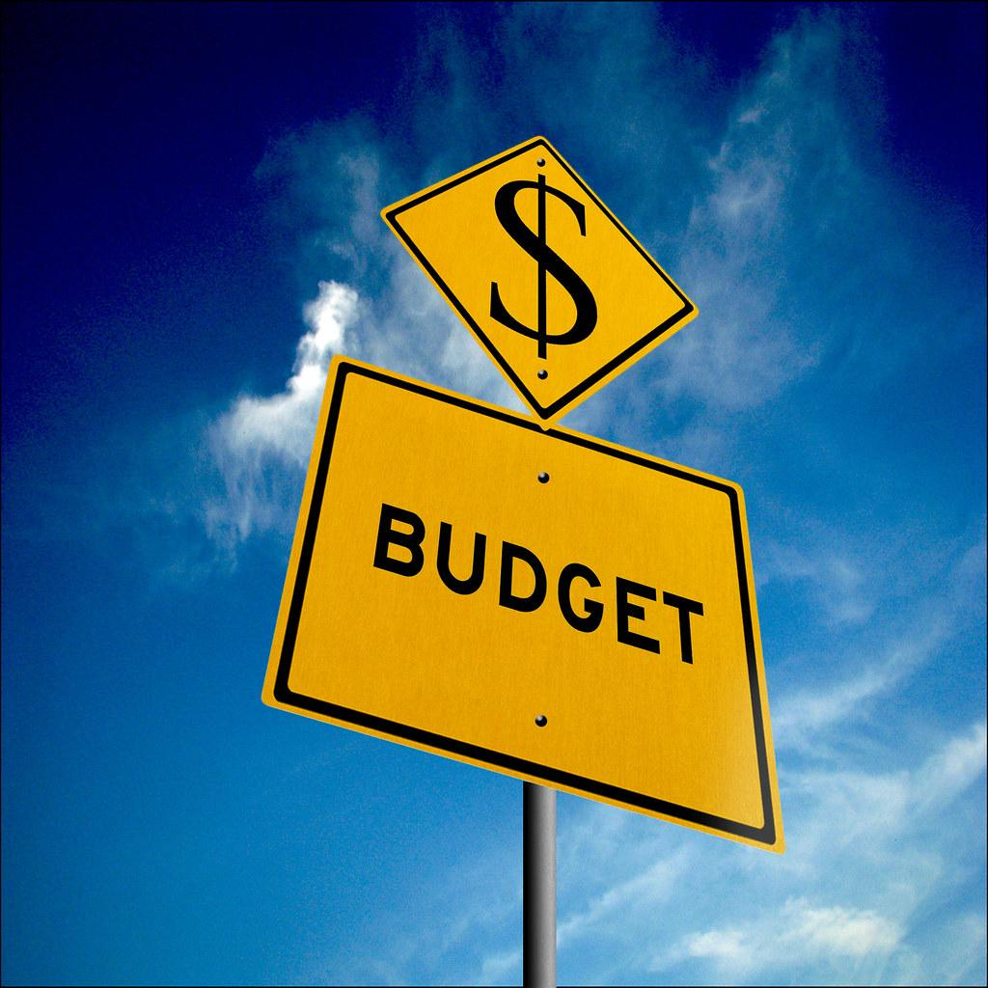
BJC’s Goals for the County Budgeting Process
BJC’s overarching goal is to continue to shift the budgeting culture in Contra Costa County from a deeply internalized and non-transparent process to one that is more democratic and inclusive, by urging the county to focus on an explicit set of values and priorities, especially regarding racial and social equity. These values would in turn provide a framework for developing innovative budget processes and priorities, based on deep and authentic community engagement.

Slide 5
The Budget is a MORALmoral document.
A set of values and principles that guide decision-making. A key to considering how those most impacted by the budget are affected by our choices.

Slide 6
Let’s Advocate Together!!

Slide 7
Public
Elects BoS/officials, pays taxes, approves funding measures
ROLES
BOS: Sets vision/priorities, establishes financial policies, ensures resource alignment, and adopts the budget
County Administrator: Prepares annual budget for BOS approval
Departments Present annual budget request to CAO

Slide 8
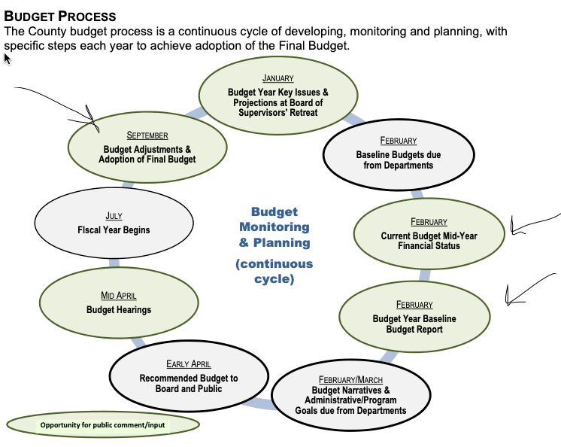

Slide 9
Why is
Budget advocacy
Important?

Slide 10
Building Community Power
Educate Yourself and Mobilize Your Community
Collaborate with Local Organizations and Coalitions
Leverage Data and Research

Slide 11
Stepping Into Leadership
Engage with Policymakers
Utilize Public Forums and Hearings
Advocate for Transparency and Accountability

Slide 12
Being An Active Advocate
Support local issues by providing public comment, attend meetings, share information and efforts with other community residents
Attend Advisory committee meetings i.e Equity Committee
Sample public comment insert here,toolkit, etc

Slide 14
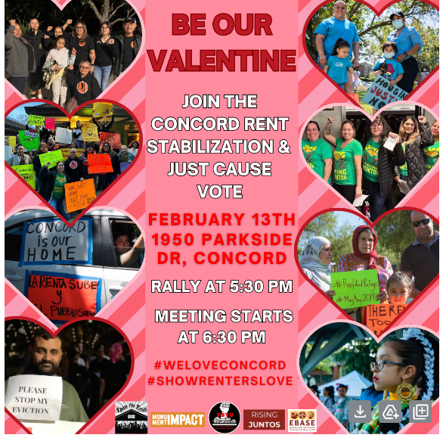
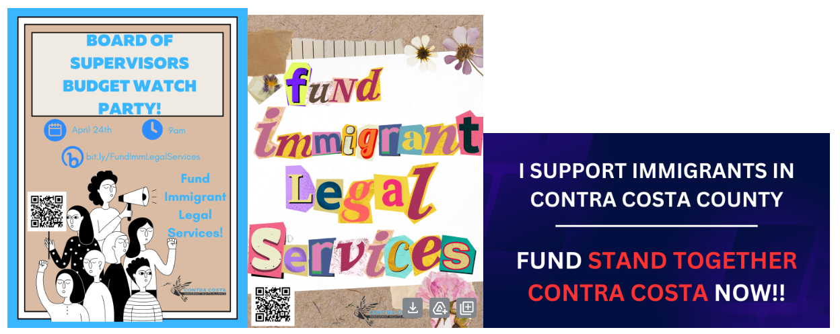

Slide 15
Upcoming events in the Budget Cycle
April 22 & 23 Public Budget hearings May 21 Final budget adoption
TO LEARN MORE ABOUT CONTRA COSTA COUNTY’S BUDGET, JOIN OUR COALITION!
How YOU Can Get Involved!

