Slide 1
Centering Lived Experience for Effective Advocacy
Staff: Cassidie Carmen Bates, Hailey Solares
Community Advocates: Bryan Espinoza, Jenny Berten

Slide 2
Agenda
Session Overview​
Brief Presentation​
Food Bank 101​
What is Advocacy
Finding your “why”
Community Advocates​

Slide 3
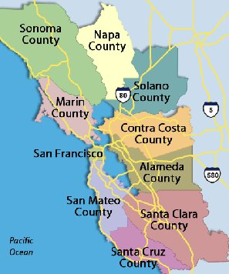
Food Bank Background
Service Area​
The Food Bank of Contra Costa and Solano County primarily serves Contra Costa and Solano counties ​
We also provide support to 16 additional Northern California counties through our Feeding America affiliation

Slide 4
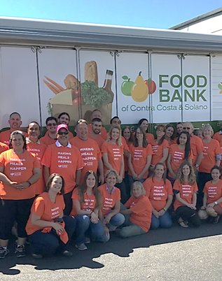
Food Bank of CCS
Operating since 1975​
Stores and distributes donated and purchased perishable and non-perishable food directly to members at community sites and through our agencies​
8,000 volunteers/monthly, 120+ staff, truck fleet, and two warehouses over 144,000 sq. feet​
For every $1 donated, the FBCCS provides enough food for two meals

Slide 5
Food Bank of CCS
Offer programs 7 days a week​
Partner with 260+ non-profit agencies​
Distributed over 60 million pounds of food in FY21​
Coordinate over 100k volunteer hours/year​
Serve 1/4 residents​
1/4 recipients are children​
​

Slide 6
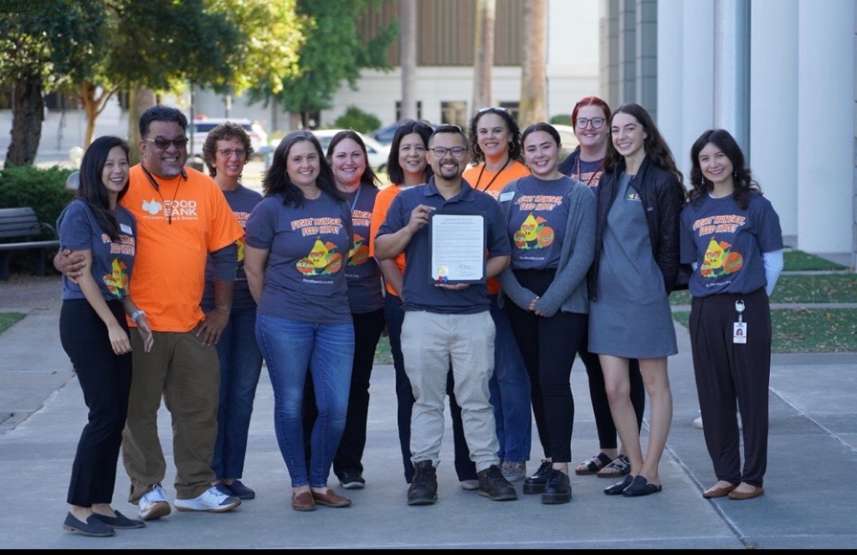
What is Advocacy?
Defining “advocacy”:​
Activity by a group or person that aims to influence a decision​
Public support for a recommendation for an issue​
Increase awareness on the topic​
What does it mean to be an Advocate?​
As an advocate YOU have the ability to be the voice for those who don’t feel they are being heard and ensure they are being respected.
All of us in this group are working on being advocates for ourselves, one another and all of those in our community without a voice.

Slide 7
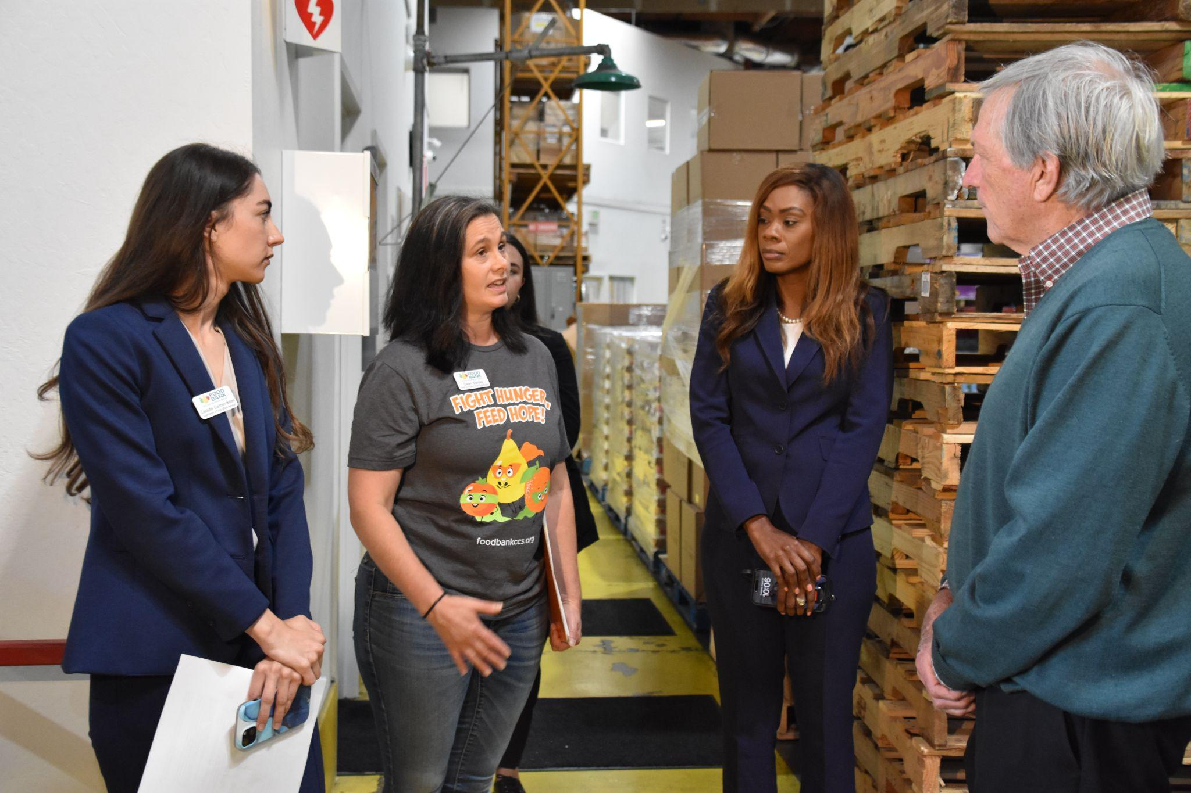
Examples of Advocacy
Engage with elected officials and advocate for anti-hunger policies
Lobby Days, Hills Visits, Updates, etc.
Letters of support
Town halls
Coalition building and strong partnerships

Slide 8
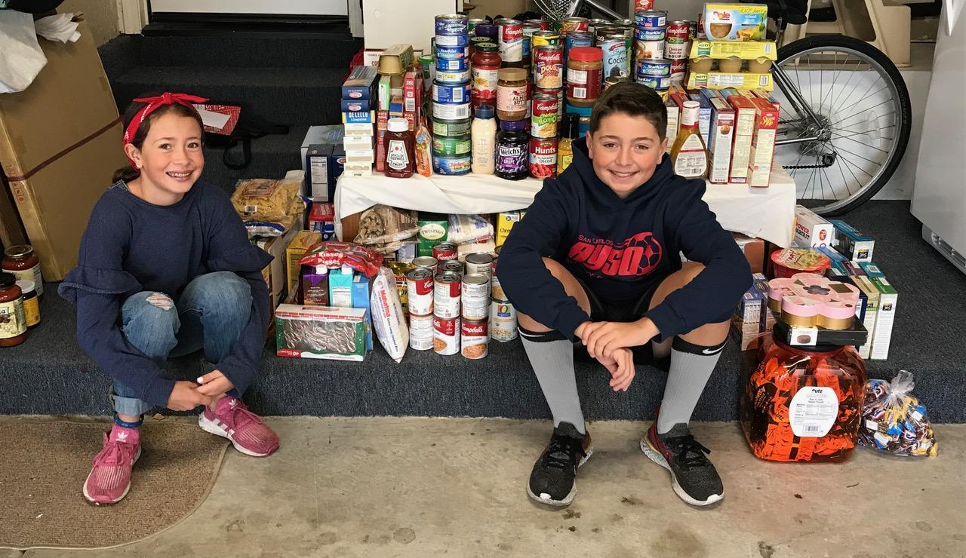
Find your “Why”!
Simon Sinek Video

Slide 9
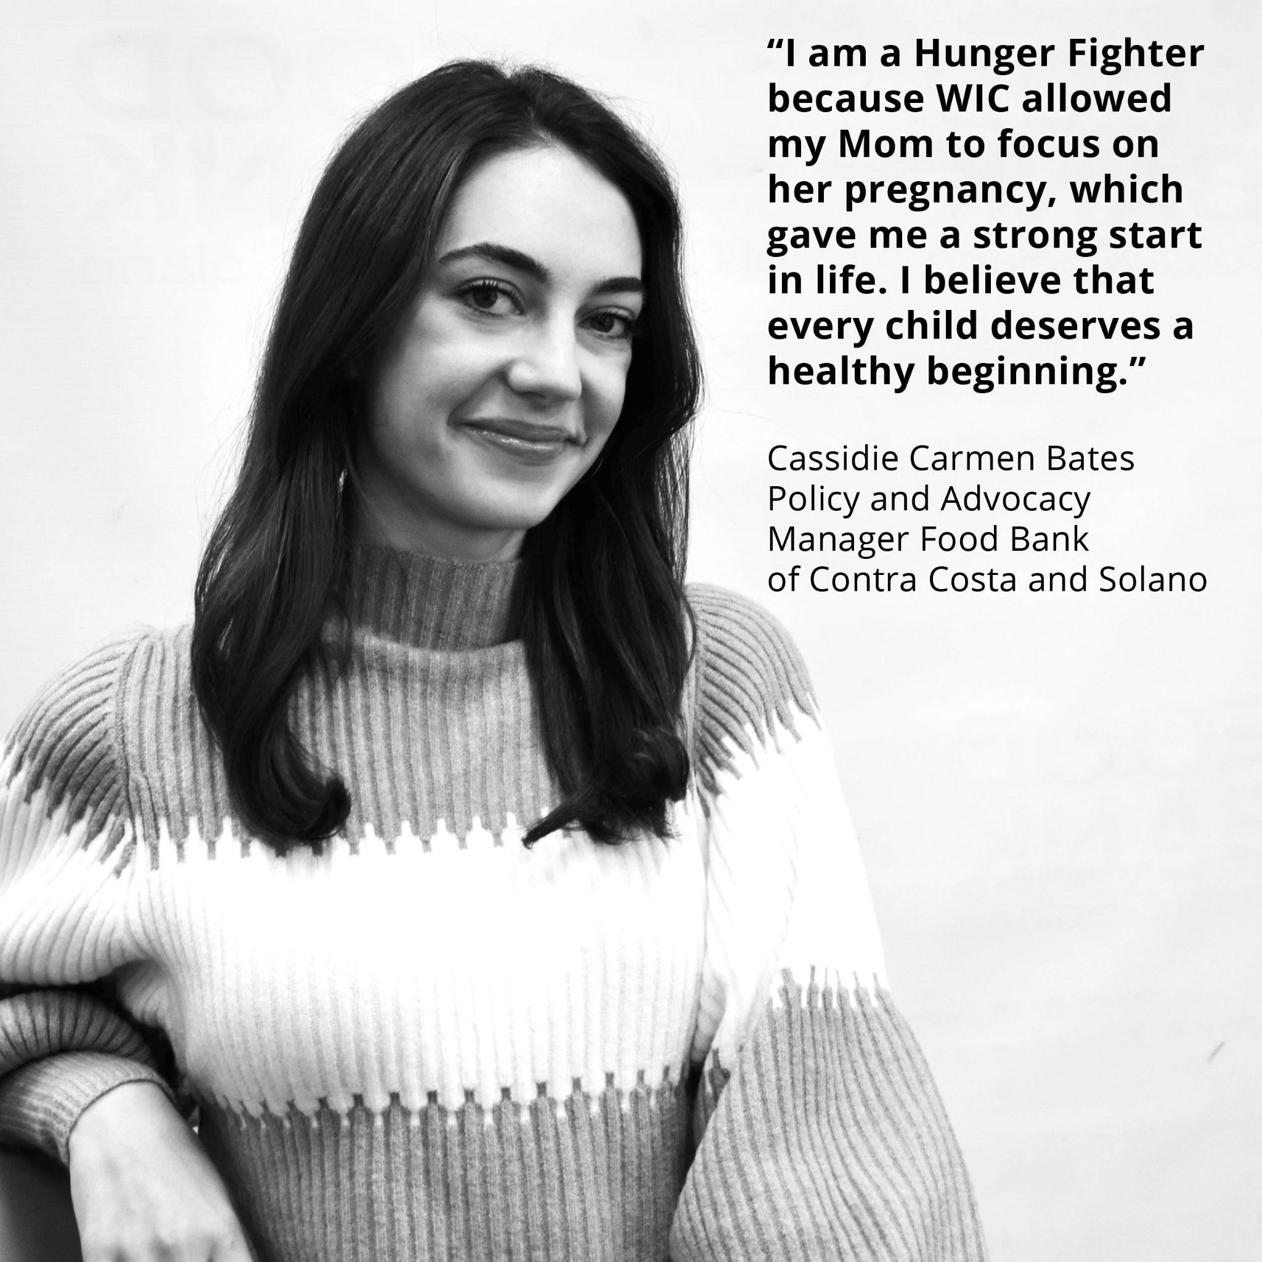
Example of WHY Statement

Slide 10
Our Advocacy Goal
Our Advocacy Goal is to identify the root causes of hunger, specific to our region while integrating the experiences and voices of our community members to most effectively advocate for sustainable change in our food systems to eliminate food insecurity

Slide 11
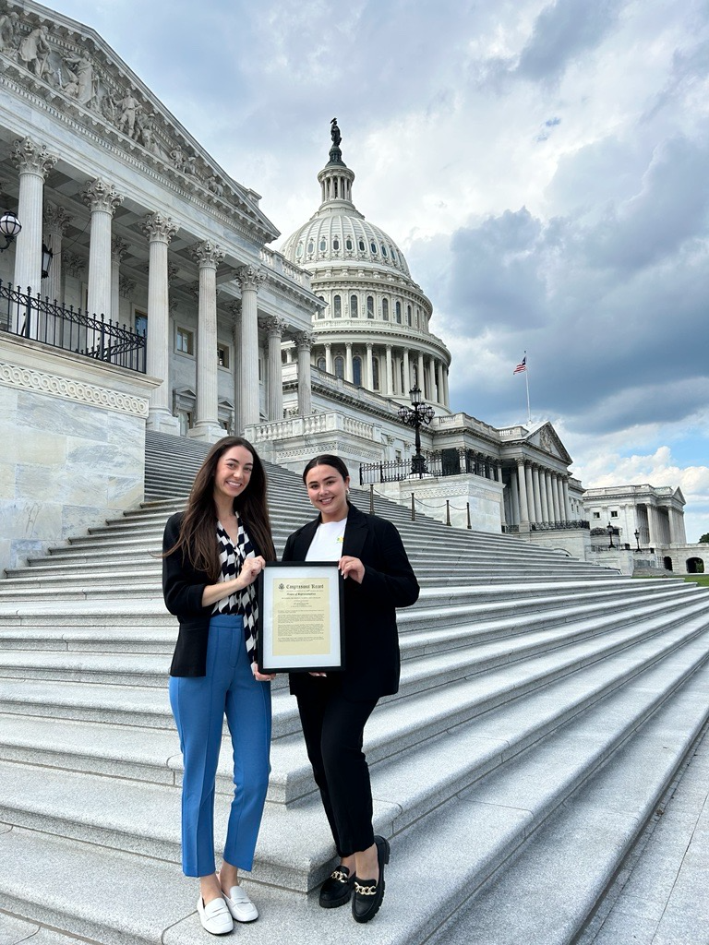
Advocacy Team Logistics & Programs
​
Advocacy Team​
Team History​
Organizational Structure​
Focus within our org & role of Advocacy​
Relationship with elected officials/lobbying
Legislative agenda
Community relationships
Community-Based Advocacy Programs​
Speaker Series​
Community Advocacy Program (CAP)

Slide 12
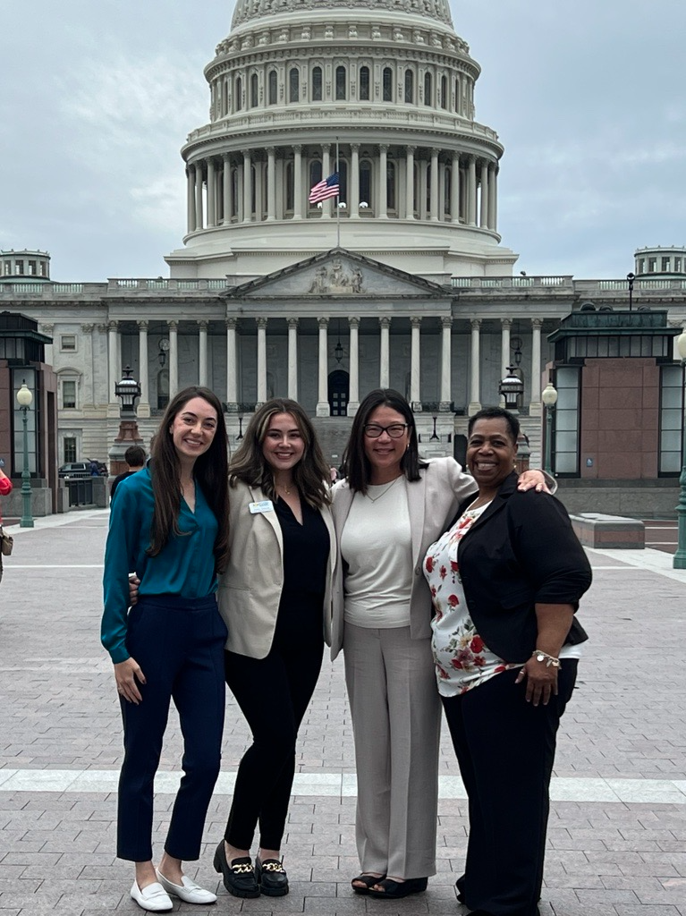
Speaker Series
Our annual Advocacy training program ​
For community members with lived experience and those passionate about ending hunger​
This program aims to amplify the voices of those impacted by food insecurity and provide the tools to effectively advocate​
Identification of 'WHY', legislative process, public speaking best practices​
​

Slide 13
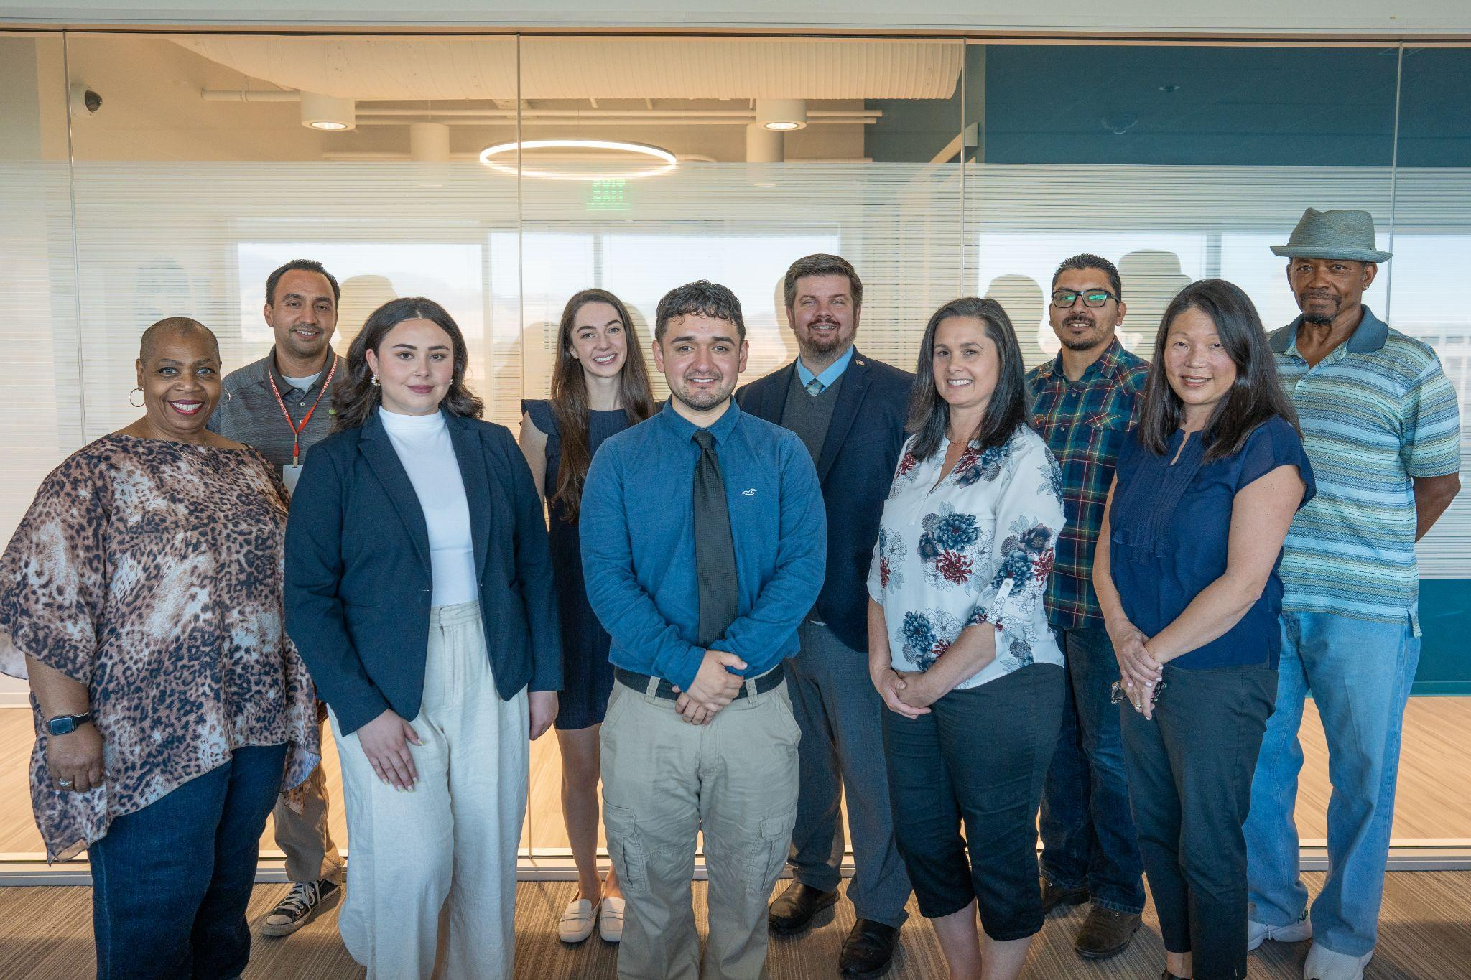
Community Advocacy Partnership
Our Speaker Series graduates are invited to join this partnership​
CAP members help us to advance the Food Banks’ mission of fighting hunger through the legislative process​
Ongoing opportunities​
I.e., creation of annual legislative agenda ​
Professional Development ​

Slide 14
CAP Objective
CAP allows our advocacy efforts to be intentional and inclusive of the qualitative aspects of our anti-hunger agenda. CAP makes our organization stronger and more diverse, and, therefore, better positioned to serve everyone in our community. ​
​

Slide 15
Examples of CAP Opportunities
Meetings with Elected Officials​
Elected officials and their staffs enjoy meeting with constituents who are volunteer advocates​
Personal stories put a face to data, statistics, and policy​
Benefit of virtual vs in person​
Engaging with Legislation of local, state, and national levels​
County Partnerships & Workgroups​
Research on Root Causes​
Education of food insecurity and advocacy​
Informing FBCCS Policy Agenda

Slide 16
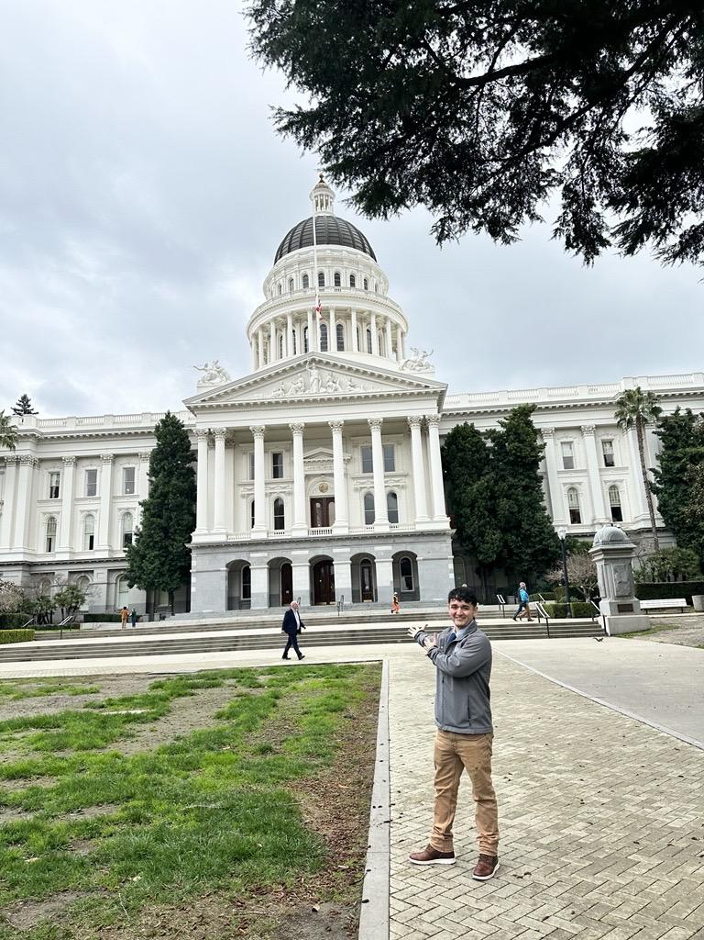
Hearing from our Community Advocates
Bryan Espinoza
Bryan is a Hunger Fighter at the Food Bank of Contra Costa and Solano. He is a CalFresh Outreach Program Coordinator who assists individuals and families through the application process for the EBT card while providing additional resources. Bryan also has experience as a Street Outreach Coordinator in Livermore (2021-2022), delivering hot and ready meals, hygiene kits, and donated clothes to unhoused populations.
Bryan’s passion for ending hunger stems from his time as a college student at UC Irvine with a low food budget of $40 per week. He had no idea about programs such as CalFresh at the time, which he would have been eligible for. Bryan is dedicated to making CalFresh and other resources known to our neighbors in need while also fighting for easier access to food in unhoused communities.

Slide 17
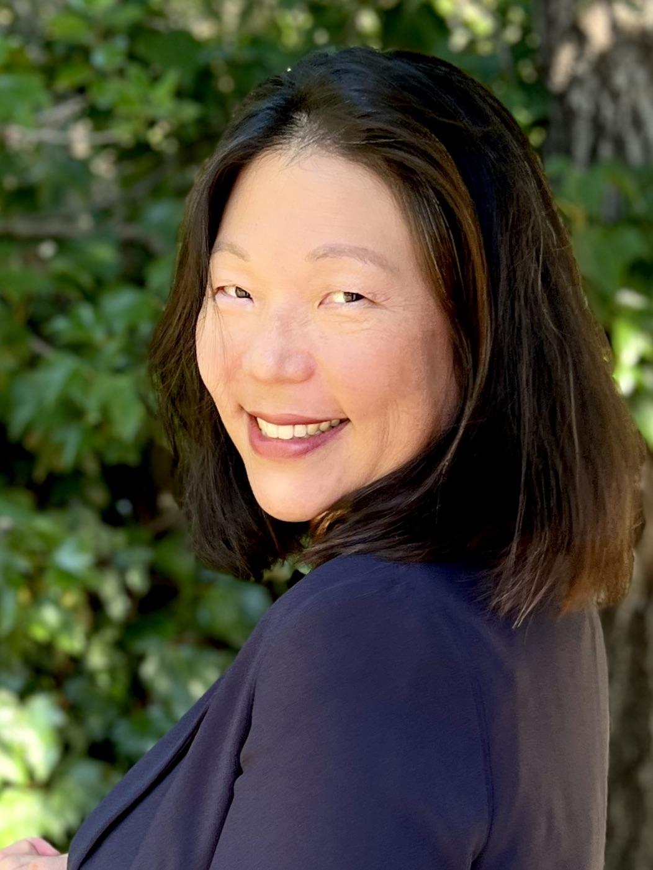
Hearing from our Community Advocates
Jenny Berten
Jenny is a Food Bank 2021 Speaker Series graduate, Community Advocacy Partner, and Board Member who welcomes opportunities to advocate for college hunger and food as medicine. Jenny is a Nurse at Saint Mary’s College of California, where she sees firsthand how food insecurity negatively impacts a student’s physical health and academic abilities. Jenny initiated USDA food insecurity screening at her college because she believes students can only reach their academic potential when they have reliable access to healthy food.
Jenny has served as a panelist at the California Association of Food Banks and Feeding America conferences, where she detailed her Speaker Series experience. Jenny has advocated for 2023 Farm Bill priorities with her elected officials in Washington DC and for the Food Bank’s legislative State priorities in Sacramento during Hunger Action Week. Jenny is honored to be a recipient of the 2023 California Hunger Action Coalition Hunger Fighter Award.

